Slide 1
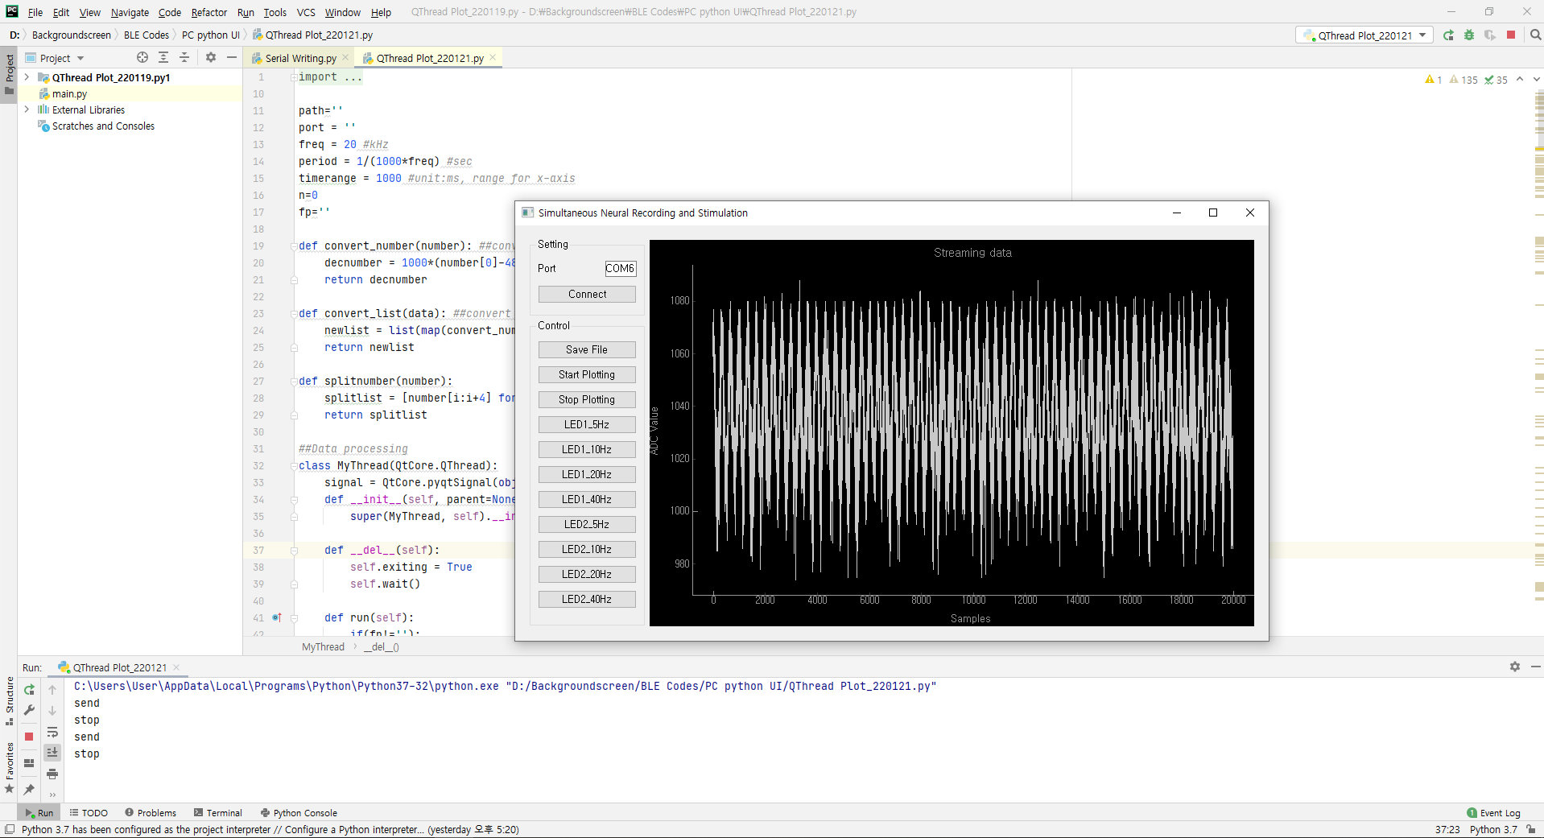
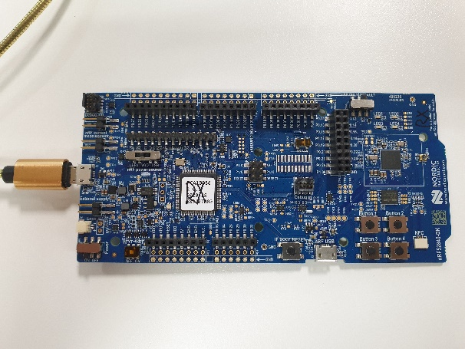
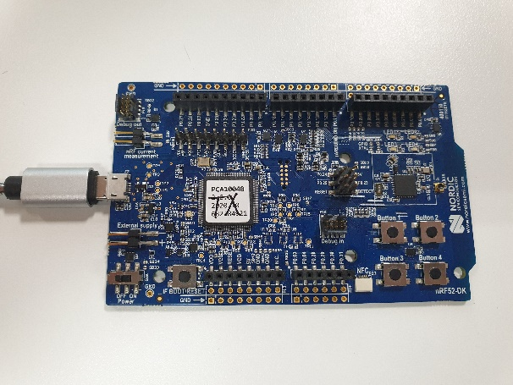
Package
RX: connect to PC.
BLE Central
TX: acts as wireless device.
BLE peripheral
Python UI: real time plotting

Slide 2
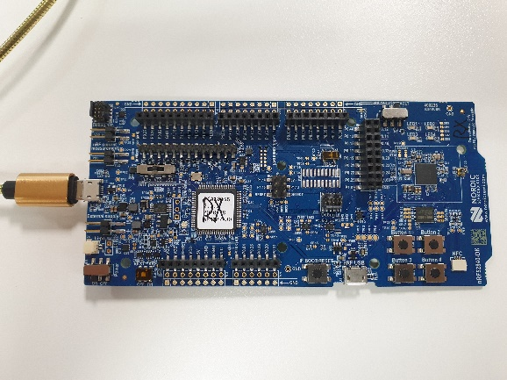

Communication schematic
BLE
USB
TX(peripheral)
RX(central)
PC(User interface)

Slide 3
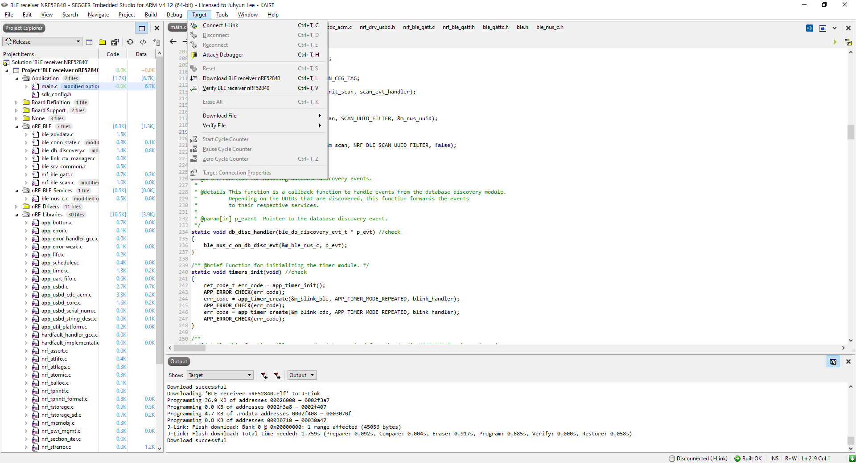
How to upload code on hardware
Firmware for hardware: written in C
IDE: Segger Embedded Studio (SES)
Open source code in SES
To upload project on the board: Target -> download ‘filename’ (ctrl + T, L)

Slide 4

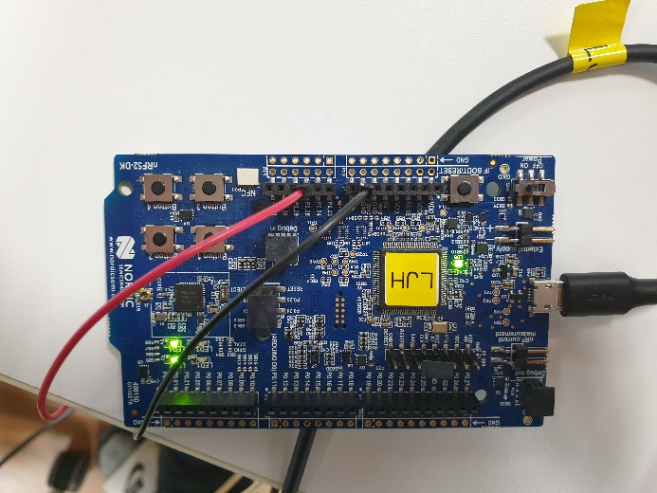
TX (nrf52832)
Get analog data (P0.28 pin in yellow box: 1 channel) and do ADC(12-bit) with 20kSamples/s speed (every 50us).
Send ADC results to RX by BLE. (1 Sample: number of 2 Bytes -> 20k*2 = 40kB/s speed)
Power: connect the enclosed cable to board (red box) and PC (USB port) OR connect power supply (3V) to ‘VDD pin’ and ‘GND pin’ on the board.
Control on/off by switch (green box)
Analog signal input: Connect function generator to ‘P0.28 pin’ and ‘GND pin’ on the board (like yellow box). Input range was set to 0~2.4V.
Source code location: \TX\src\ble_peripheral\FAST-ADC-WITH-BLE\pca10040\blank\ses -> fast_adc_with_ble.emProject

Slide 5

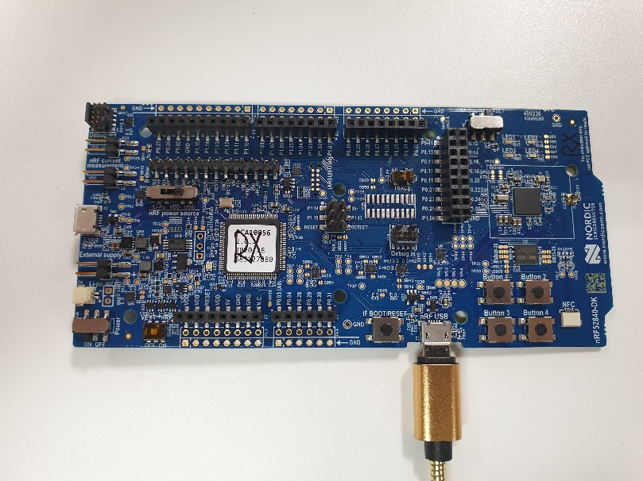
RX (nrf52840)
Receive digital data by BLE from TX and send data to PC by USB CDC.
Will be connected to peripheral device(TX) automatically when they are turned on by searching specific UUID.
Control on/off by switch (green box)
Upload code: Connect USB cable to red box and set ‘nRF power source’ to ‘VDD’.
USB communication with PC: Connect USB cable to yellow box and set ‘nRF power source’ to USB.
Source code location: \RX\nRF52840 Receiver\examples\peripheral\usbd_ble_uart\pca10056\s140\ses -> usbd_ble_uart_pca10056_s140.emProject

Slide 6
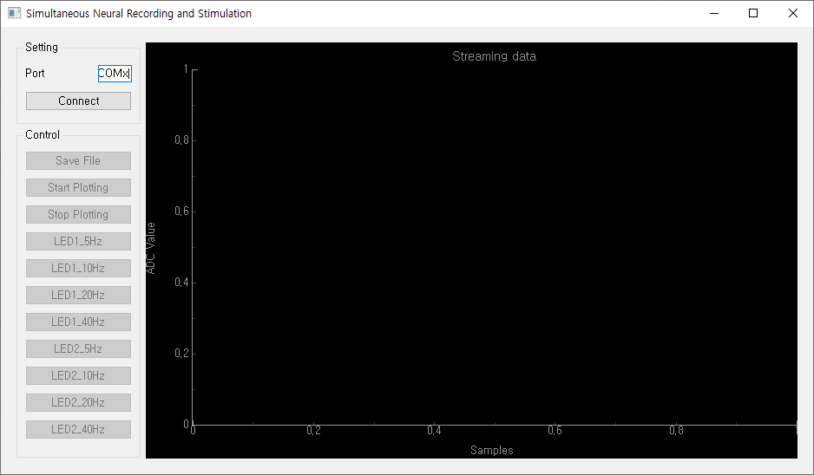
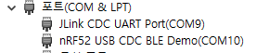
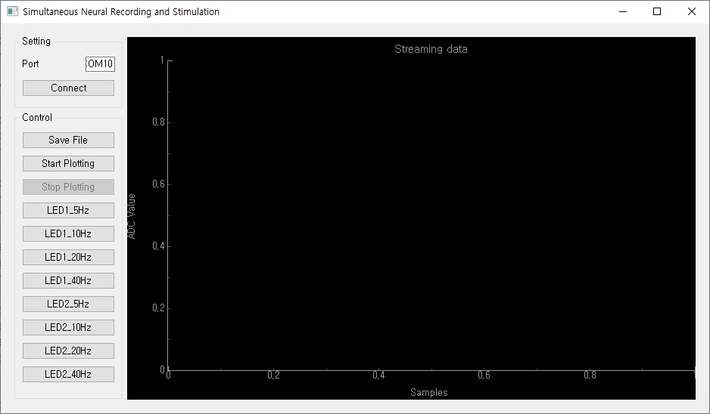
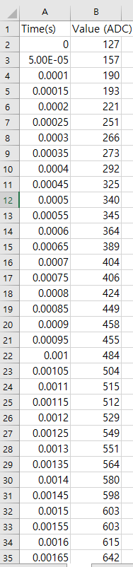
Python UI
File name: ‘Realtime plot.py’
First, turn on both RX and TX and run the program
Write port number in the red box (change x into something: write number of nRF52 USB CDC BLE Demo. In this case, write ’10’).
Click ‘connect’: interface will be changed like yellow box.
Only plotting: just click ‘start plotting’.
Also want to save the file: click ‘save file’ (select location and file name) and clock ‘start plotting’ -> After click ‘stop plotting’, you can check saved file (like blue box)

Slide 7
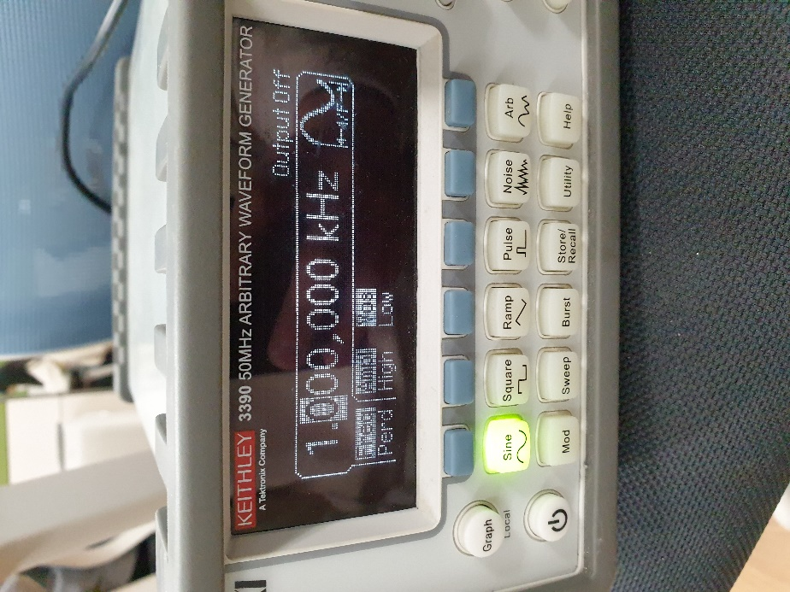
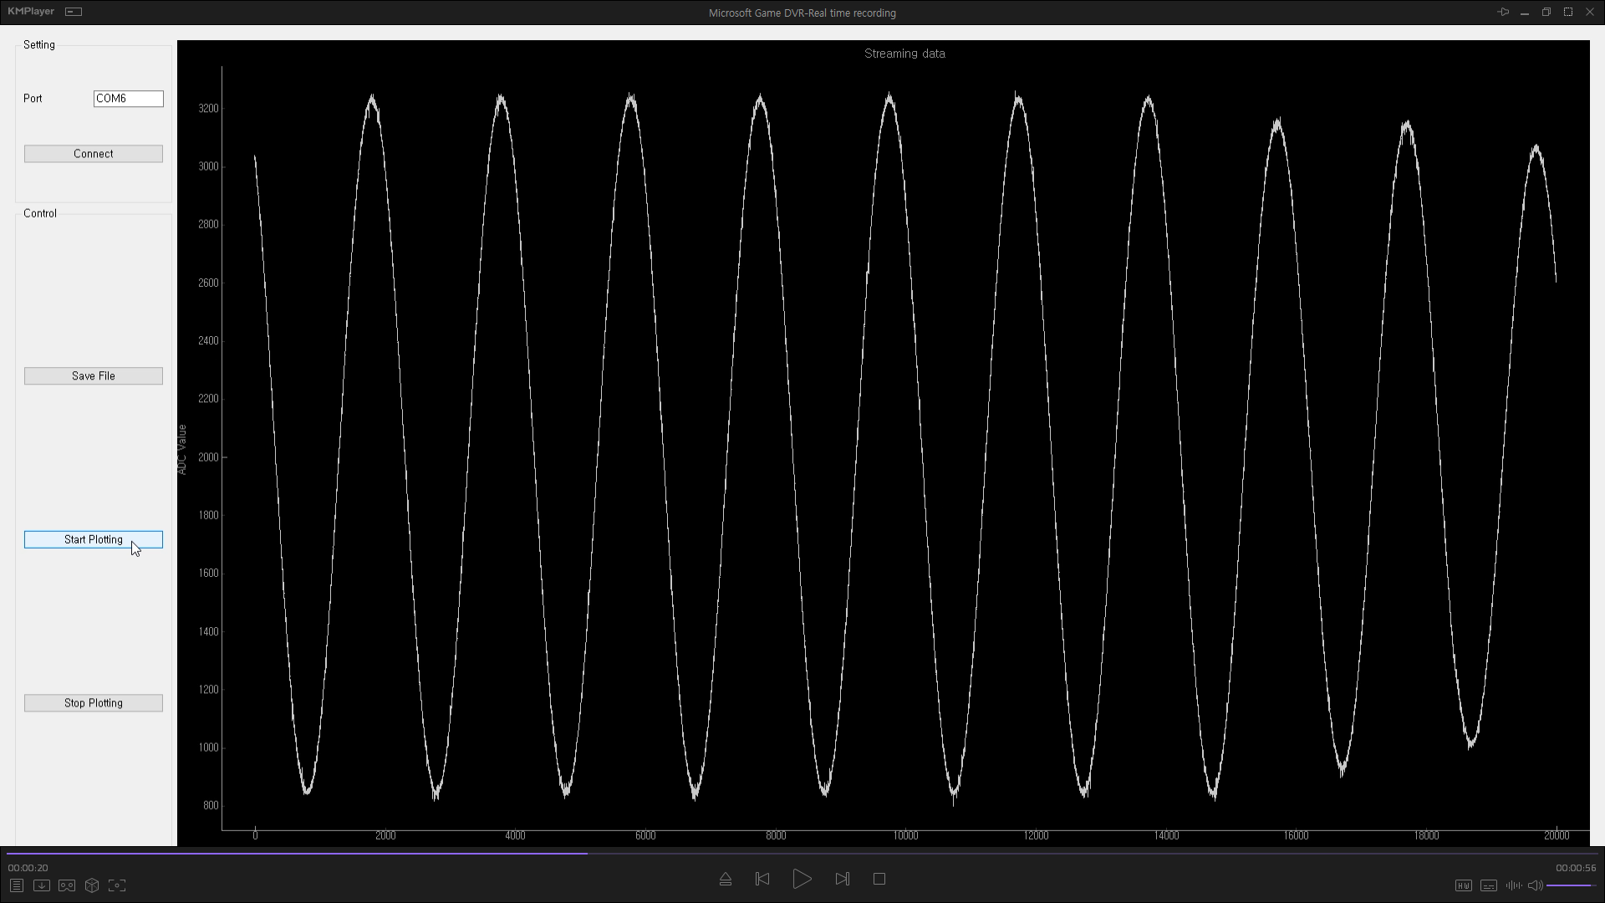
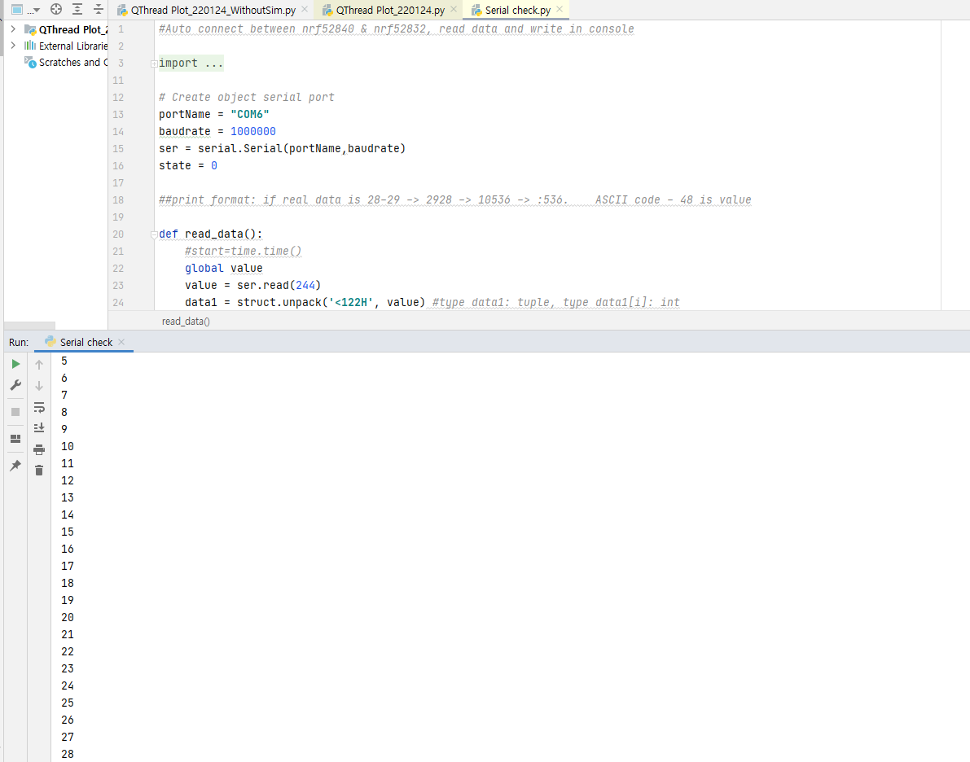
Test data
“Realtime plot.py”: you can compare original signal and plotted(or saved) signal.
Input: function generator (know the original input signal) to P0.28 pin of nrf52832 board.
Shape: doesn’t matter (I usually used sine wave)
Range: 0~2.4V -> I used sine wave with bias voltage of 1.2V and amplitude of up to 2V.
“Serial check.py”: you can check how many packets arrived
This program prints out ‘m_adc_evt_counter’.
‘m_adc_evt_counter’ is located in the last column of the packet transmitted from TX and represents the order of the packets(121+1 number in one packet). If printed discontinuously, it means that some packets have been lost. This is the number from 0 to 255, and it starts from 0 again after 255.

Slide 8
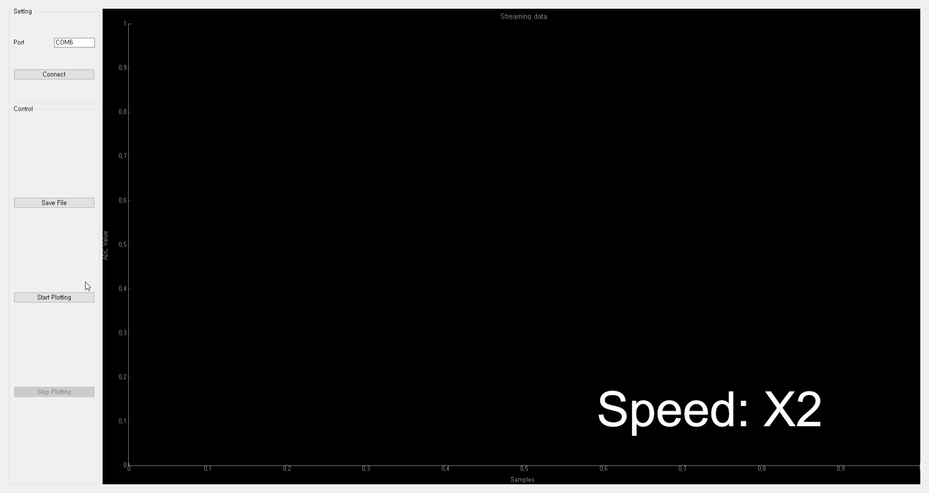
Example
Video speed: X2
Sine wave: 10~1000 Hz, 1.2±1V (amplitude changed. with small amplitude, bias voltage also changed in video)
100% transmitted (calculated by packet number)
The values that pop out sometimes: due to the sudden change in the signal from function generator

